Slide 1
Surabaya Health Care Analysis

Slide 2
Data Analysis
Source Link
Number of files 11 CSV
Number of columns 8
Periode
Wilayah
Kecamatan
Nama Puskesmas
Poli
Baru
Lama
Total Kunjungan

Slide 3
Transformation Proses
Load and transform 11 CSV files
Create additional column for sorting process due to month naming convenience in bahasa (Januari to Month 01, February to Month 02 and so on)

Slide 4
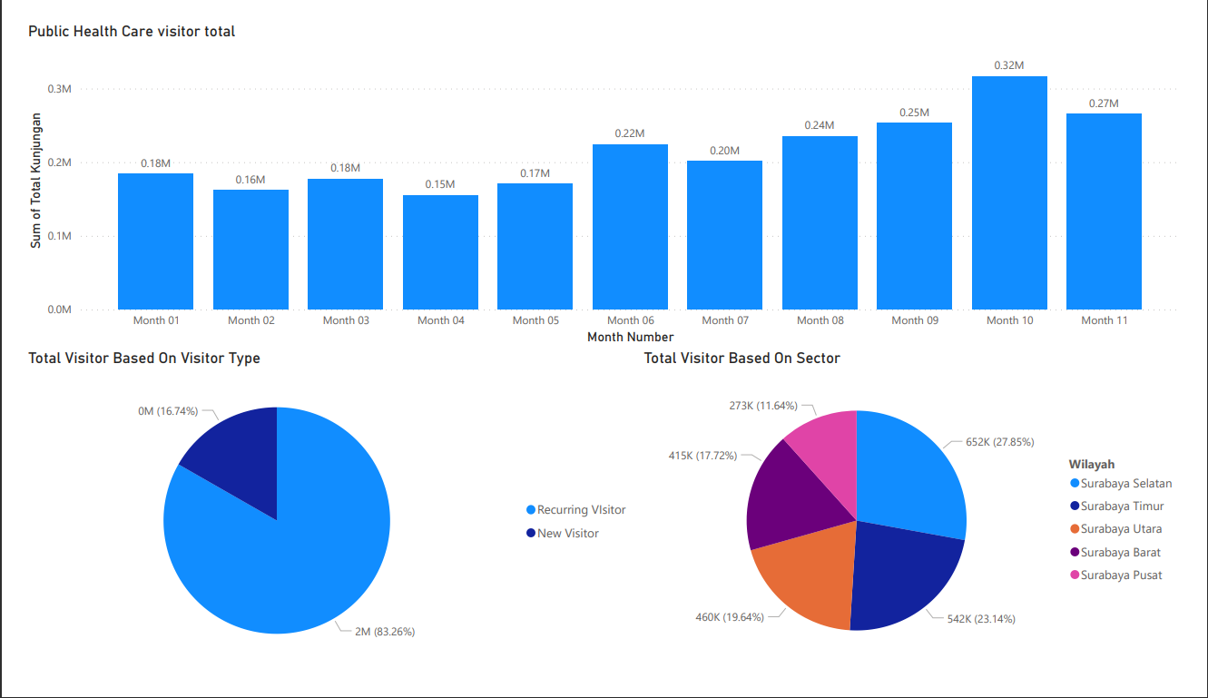
Distribution Analysis
Data distribute based on
Month January (Month 1) to November (Month 11) with maxed at month 10 (320K total Visitor) and lowest at month 04
Visitor Type Most of the healthcare visitor are recurring visitor with 2M total Visitors
Sector Surabaya selatan/south Surabaya have the most visitors from January to November 2022

Slide 5
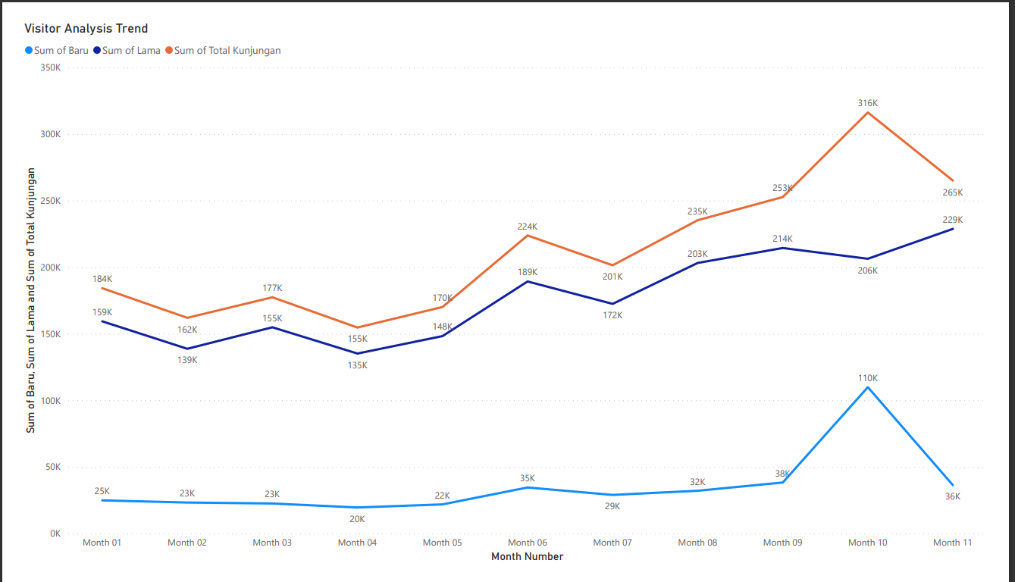
Trend Analysis (1/2)
For the trend analysis from January to November
As we can see here the number peaked in October most contributor of it from new visitor
We will zoom in to October only which healthcare and sector contribute in new visitor

Slide 6
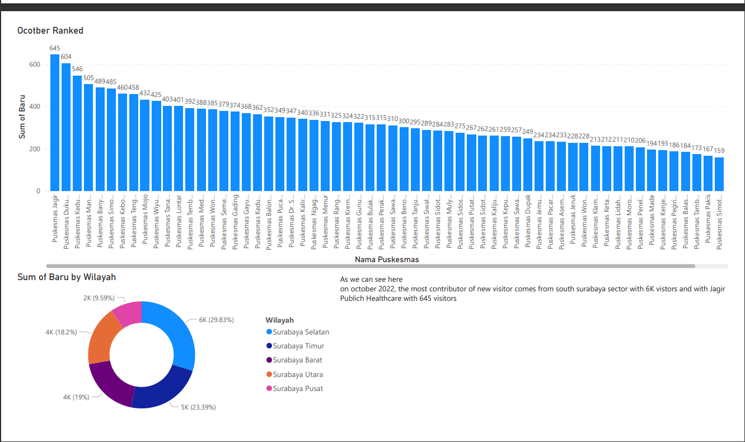
Trend Analysis (2/2)

Slide 7
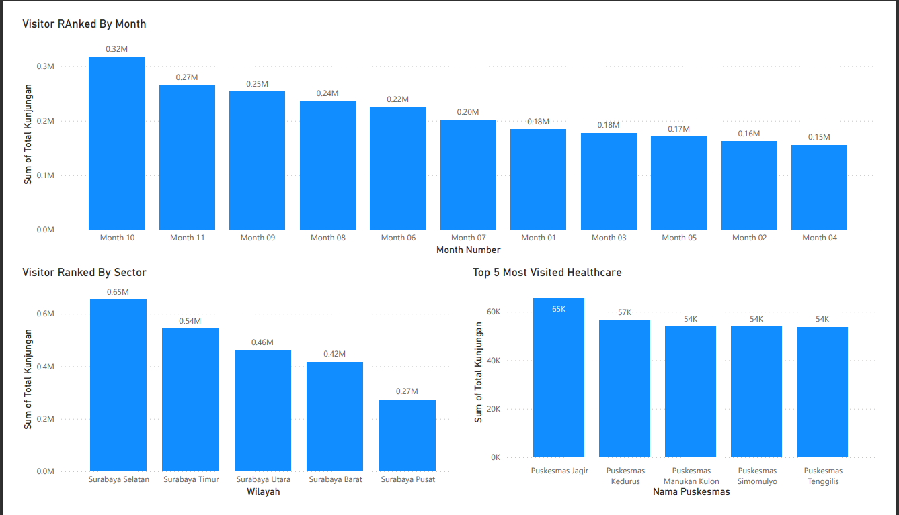
Ranking
Based on month: October with 320K
Based On Sector:
South Surabaya with 650K visitor
Based on location:
Jagir with 65K Visitor

Slide 8
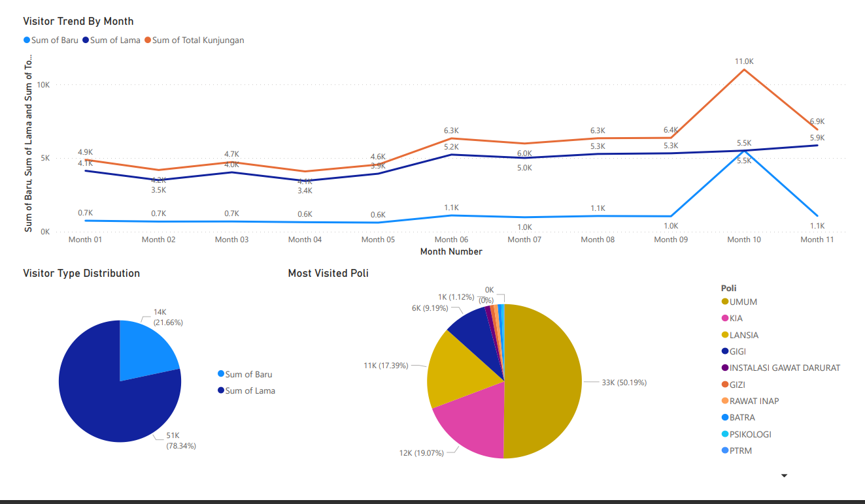
In Depth Jagir Analysis
Here we conduct a further analysis on most visited healthcare in 2022 which is Pusksesmas Jagir

